Slide 1
Beyond the Diagnosis
A Demographic & Behavioral Profiling of Autism Spectrum Traits
Course: CSD301 | Descriptive Analytics Project
Group: Insight Igniters | Yagya Mahajan & Arnav Jain
CA2 — EDA & Visualizations

Slide 2
Problem Statement
⚠ The Challenge
🔬 Our Approach
🎯 Beyond Binary
ASD presents diverse manifestations across demographics. The challenge: how do behavioral traits like eye contact, social mimicry, and gestural communication vary across gender, age groups, and medical history?
Systematically analyzing 6,075 screening records to uncover hidden demographic disparities, identify behavioral clusters, and map how autism spectrum traits manifest across diverse populations.
Moving beyond a simple Yes/No diagnosis to reveal the spectrum's complexity — through composite scores, behavioral archetypes, and intersectional risk analysis.

Slide 3
Project Objectives
1
Identify Demographic Patterns
Analyze how ASD traits vary across gender, age groups, and medical risk factors.
2
Uncover Behavioral Clusters
Discover correlations between specific observable behaviors and ASD diagnosis.
3
Assess Risk Factors
Evaluate cumulative and isolated impact of jaundice history and family genetics on ASD.
4
Generate Actionable Insights
Move beyond binary diagnostic categories to create comprehensive spectrum profiling.
5
Build Composite Scoring Systems
Develop aggregated metrics — Social Interaction, Communication Deficit, and Behavioral Atypicality scores.

Slide 4
Dataset Overview
6,075
15 → 26+
Total Records
Features (Raw → Engineered)
0
70.3% / 29.7%
Missing Values
ASD Negative / Positive
57.8%
50.9%
Male | 42.2% Female
Adults | 37.9% Children | 11.2% Adolescents

Slide 5
Behavioral Assessment Questions: A1–A10
Ten binary (0/1) questions assessing foundational autism spectrum traits. Score 1 = trait present, 0 = absent (exception: A10 scores 1 for atypical behavior).
Col
Question
What it Measures
A1
Eye contact when called
Responsive attention orienting
A2
Easy for others to get eye contact
Spontaneous eye contact ability
A3
Point to request something
Imperative pointing (request-based)
A4
Point to share something interesting
Declarative pointing (social sharing)
A5
Engage in imaginative / role-play
Imaginative play capacity
A6
Follow others' gaze
Joint attention & gaze-following
A7
Comfort someone upset
Empathic response & emotional awareness
A8
Communication style described as typical
Self-assessment of communication
A9
Use common gestures (e.g., waving)
Gestural communication proficiency
A10
Sometimes stare into space
Atypical attention pattern (direct score)

Slide 6
EDA & Visualizations
What the data revealed — findings and insights

Slide 7
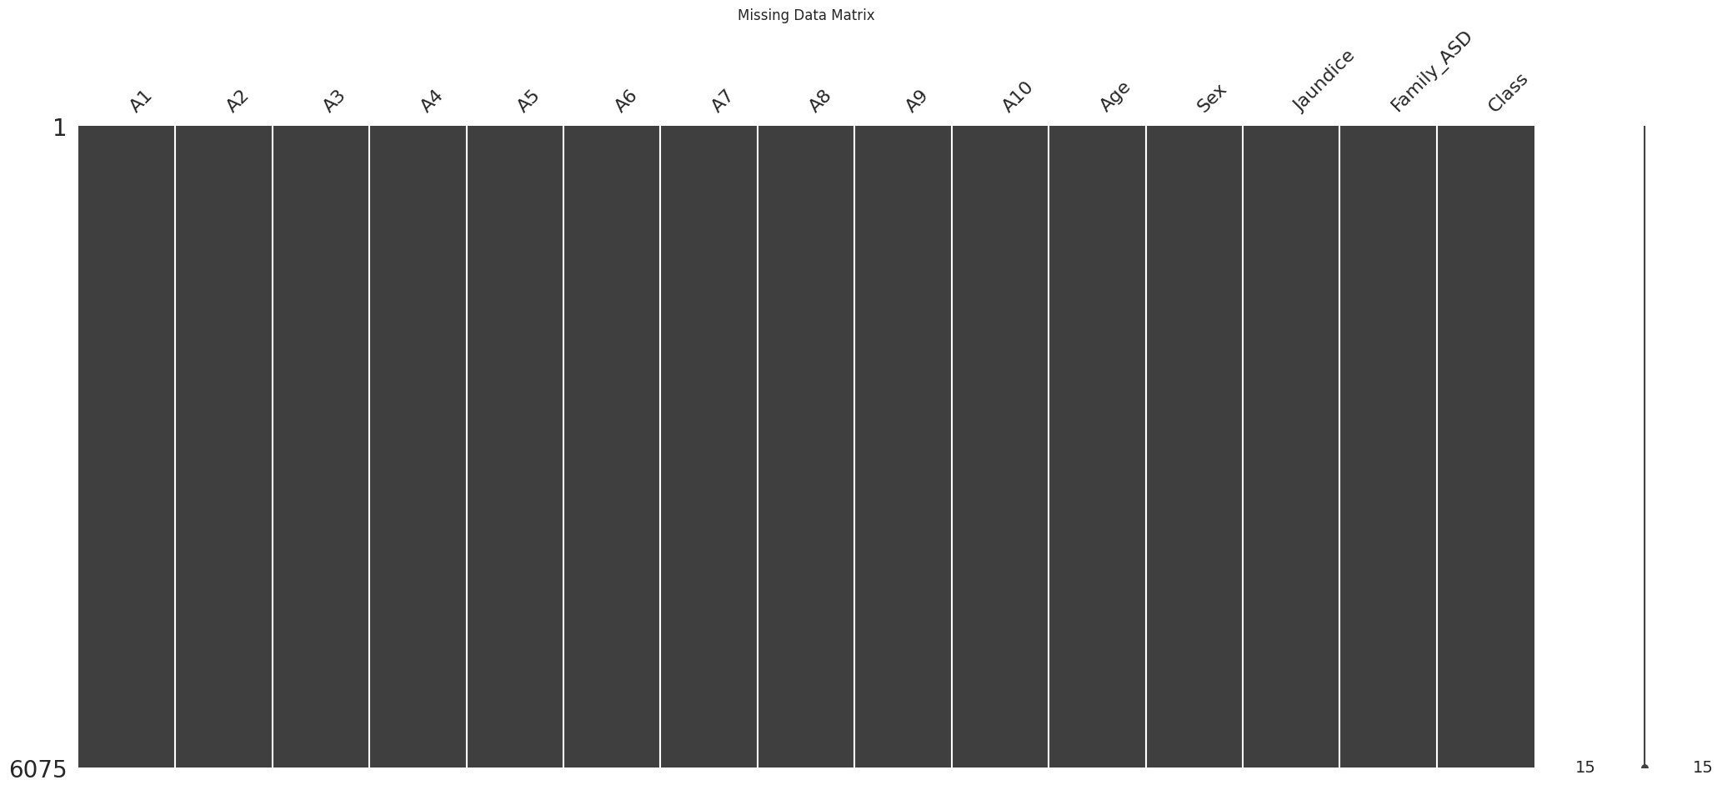
Data Completeness — Missing Value Matrix
Key Finding
The missingno matrix confirmed a perfect dataset: all 6,075 records are complete across every column with zero missing values.
This is rare in real-world clinical data and eliminates any need for imputation, ensuring all downstream analysis is built on a fully reliable foundation.
Fig 1: missingno matrix — solid bars confirm 100% completeness

Slide 8
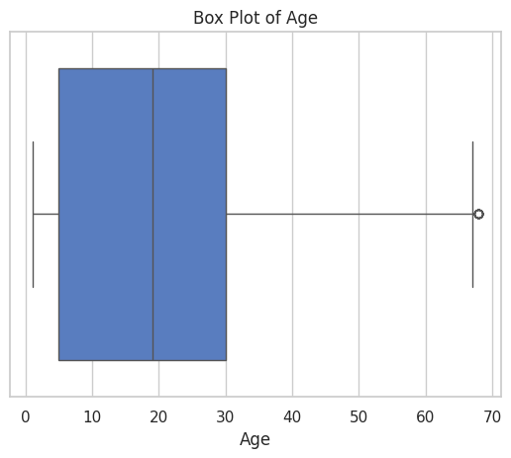
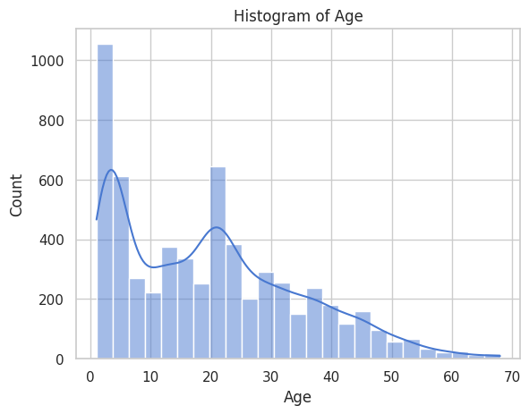
Age Distribution — Outlier Treatment & Profiling
Key Finding
Ages range 1–68 with mean of 19.84 years.
The IQR method (Q1=5, Q3=30, IQR=25) was used to cap extreme outliers at the upper bound of 67.5 (Winsorization).
Why Winsorize? To prevent extreme ages from skewing composite score distributions and distorting demographic comparisons — without discarding any records.
The histogram shows a right-skewed distribution with two peaks: a large early-childhood cluster and a second young-adult cluster.
Age Group
Count
% of Dataset
Child (<13 yrs)
2,303
37.9%
Adolescent (13–17)
678
11.2%
Adult (18+)
3,094
50.9%

Slide 9
EDA — The Gender Presentation Gap
Do males and females differ in ASD diagnosis rates?

Slide 10
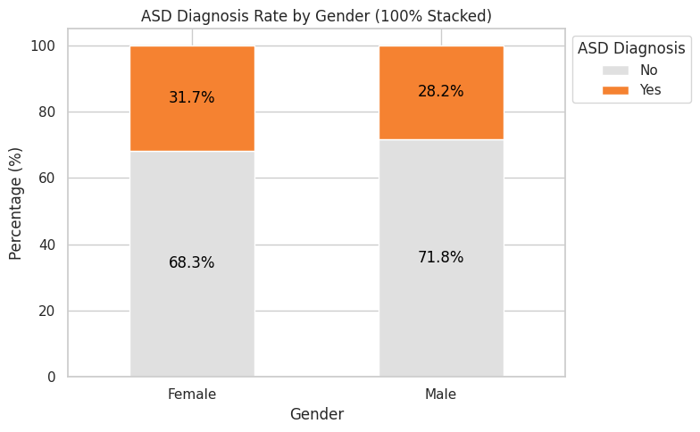
ASD Diagnosis Rate by Gender (100% Stacked Bar)
Key Finding
Females show a slightly higher positive diagnosis rate (31.7%) compared to males (28.2%).
This challenges the historically male-dominated ASD narrative in clinical literature. The data suggests females may be undergoing screening at higher diagnostic thresholds, or presenting with traits that are currently being detected.
This gender gap is a critical baseline finding that motivates deeper intersectional analysis.
Fig 2: 100% stacked bar — ASD rate by gender

Slide 11
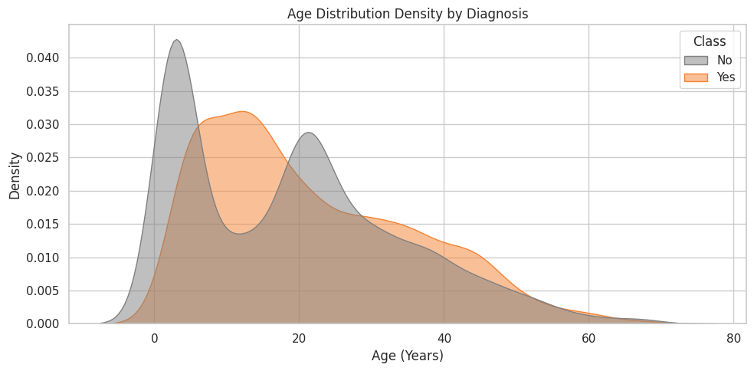
Age Distribution Density by Diagnosis (KDE)
Key Finding
Two distinct screening waves are visible:
1. Early Childhood Peak (ages ~5–10): Represents proactive early intervention — the standard recommended window for ASD diagnosis.
2. Young Adult Peak (ages ~20–30): A second wave of diagnoses in adulthood, suggesting many individuals were missed during childhood screening.
The diagnosed (orange) group shows a proportionally heavier young adult peak than the undiagnosed (gray), implying late-identified adults are a substantial clinical population.
Fig 3: KDE density by diagnosis — multimodal age peaks

Slide 12
EDA — Medical Risk Factors
Jaundice, Family ASD history, and their combined impact

Slide 13
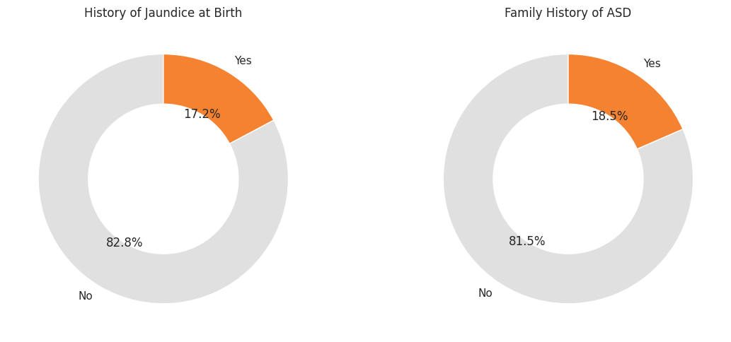
Prevalence of Medical Risk Factors
Key Finding
Two independent baseline risk factors were measured:
• Jaundice at Birth: 17.2% prevalence (1,045 individuals). Neonatal jaundice causes bilirubin toxicity, a known neurological risk factor.
• Family ASD History: 18.5% prevalence (1,122 individuals). Genetic predisposition is one of the strongest known ASD risk factors.
The similarity in prevalence rates (~17–18%) makes them ideal for intersectional analysis to study compounding risk effects.
Fig 4: Donut charts — individual medical risk factor prevalence

Slide 14
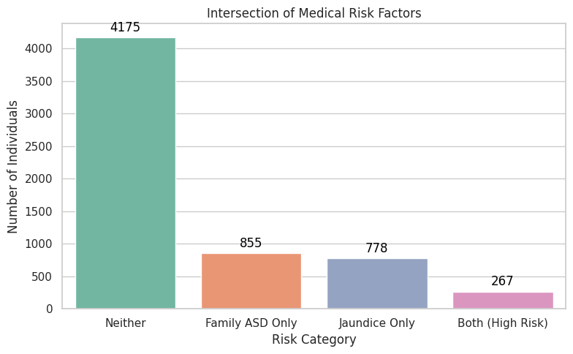
Risk Factor Intersection — Segmentation Result
Key Finding
The four mutually exclusive risk groups revealed:
• Neither risk factor: 4,175 (68.7%)
• Family ASD Only: 855 (14.1%)
• Jaundice Only: 778 (12.8%)
• Both (High Risk): 267 (4.4%)
The 267 dual-risk individuals form a critical high-risk cohort. Why engineer this? Rather than analyzing each risk factor in isolation, combining them captures compounding biological vulnerability — which is clinically more meaningful.
Fig 5: Risk overlap countplot — four mutually exclusive groups

Slide 15
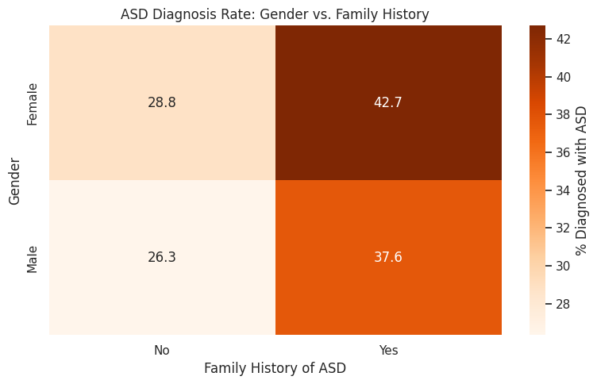
Demographic Risk Heatmap — Gender × Family History
Key Finding
The cross-tabulation of gender and family ASD history reveals a compound risk gradient:
• Females + Family ASD: 42.7% diagnosis rate — the single highest risk subgroup in the dataset.
• Males + Family ASD: 37.6%
• Females, no family history: ~28%
• Males, no family history: ~26%
The finding that genetic history amplifies female diagnosis rates disproportionately more than male suggests complex gene-sex interaction effects in ASD presentation.
Fig 6: Heatmap — % ASD diagnosis by gender × family history

Slide 16
Feature Engineering
Why we built these features — not how

Slide 17
Composite Scores — Why We Built Them
Social Interaction Score (0–3)
A1 + A2 + A6
A1, A2, and A6 all measure eye contact and gaze behavior — the core nonverbal social channel. Summing them creates a continuous signal of social engagement strength rather than treating each as isolated yes/no answers.
Communication Deficit Score (0–3)
(1–A3) + (1–A4) + (1–A9)
Pointing and gesturing are the backbone of pre-verbal communication. Inverse coding (1 – value) flips the direction: absence of the ability becomes presence of the deficit. Higher scores expose greater communication breakdowns.
Behavioral Atypicality Score (0–4)
(1–A5) + (1–A7) + (1–A8) + A10
Combines absence of normative behaviors (imagination, empathy, typical communication) with a direct atypical one (space-staring). This captures behavioral divergence from expected norms in a single clinical number.
Total Atypical Trait Burden (0–10)
Inverse sum of A1–A9 + A10
A global severity metric across the full A-scale. Enables ranking patients on a single clinical scale — essential for comparing across demographics and validating the other sub-scores.

Slide 18
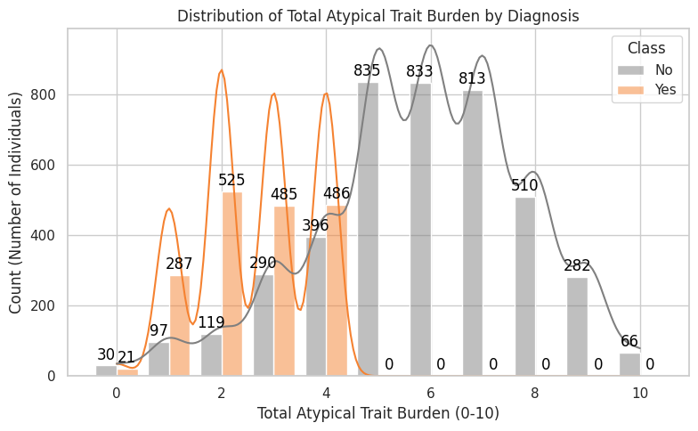
Total Atypical Trait Burden Distribution by Diagnosis
Key Finding
The trait burden distribution shows a clear separation between diagnosed and undiagnosed:
Diagnosed (ASD Yes): Heavy concentration at higher burden scores (6–10), with a peak around 7–8.
Undiagnosed (ASD No): Concentrated at lower-to-mid burden scores (2–5).
This validates that the Total Atypical Trait Burden is a clinically meaningful severity gradient — not a random aggregation — and confirms it can differentiate population subgroups effectively.
Fig 7: Trait burden histplot with KDE — by diagnosis (Yes/No)

Slide 19
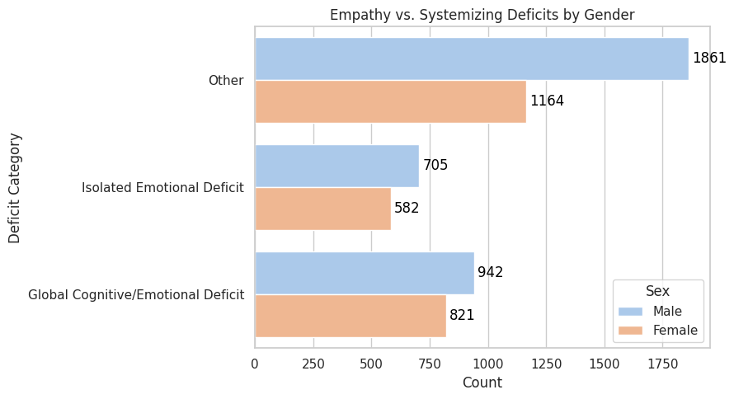
Empathy vs. Imagination Profile — Feature Engineering
Why This Feature
Empathy (A7) and Imagination (A5) represent two distinct cognitive domains that both show deficits in ASD.
Combining them separates three clinically distinct subgroups:
• Global Deficit: Both empathy and imagination are absent — the most severe dual cognitive impairment profile (1,763 individuals, 29%).
• Isolated Emotional Deficit: Can imagine and role-play, but cannot empathize — suggests intact cognitive capacity with emotional processing breakdown (1,287 individuals, 21%).
• Other: Displays typical empathy — including those with full typical function (3,025 individuals, 50%).
This is clinically richer than either A5 or A7 alone.

Slide 20
Behavioral Archetypes — Logic-Based Clustering
Why we built cascading logic thresholds instead of relying on raw scores alone:
26.2%
Severe Global Delay
Captures the most severe multi-domain presentation simultaneously.
Threshold: Social ≤1 AND Comm. Deficit ≥2 AND Atypicality ≥2
18.0%
Communication Impaired
Identifies patients who communicate poorly but remain socially engaged.
Threshold: Comm. Deficit ≥2 AND Social ≥2
14.3%
Socially Withdrawn
Catches patients who avoid social cues yet can gesture and point.
Threshold: Social ≤1 AND Comm. Deficit ≤1
6.3%
Highly Atypical Presentation
Surfaces patients with intense behavioral differences despite communicative ability.
Threshold: Atypicality ≥3 AND Comm. Deficit ≤1
35.1%
Mild/Typical Presentation
The baseline population; not a negative finding but a comparative anchor.
Threshold: Default — does not trigger any above threshold

Slide 21
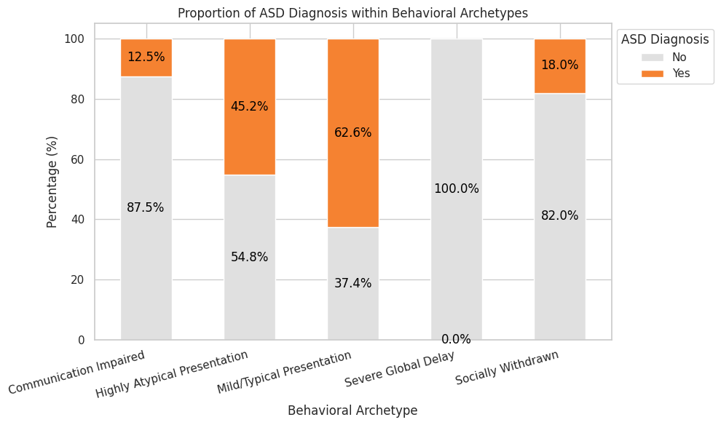
Proportion of ASD Diagnosis Within Behavioral Archetypes
Key Finding
The most surprising insight in the entire analysis:
62.58% of 'Mild/Typical Presentation' individuals received a positive ASD diagnosis — the highest of any archetype.
This reveals that ASD diagnosis does not depend solely on trait severity. Many individuals present mildly on behavioral scales but are still diagnosed, pointing to the complexity of clinical diagnosis beyond observable trait counting.
100% of 'Severe Global Delay' individuals were NOT diagnosed — possibly because severe presentations were already known and excluded from general screening.
Fig 8: Stacked bar — diagnosis proportion by archetype

Slide 22
Healthcare Proxy Flags
Late diagnosis and masking — clinical story features

Slide 23
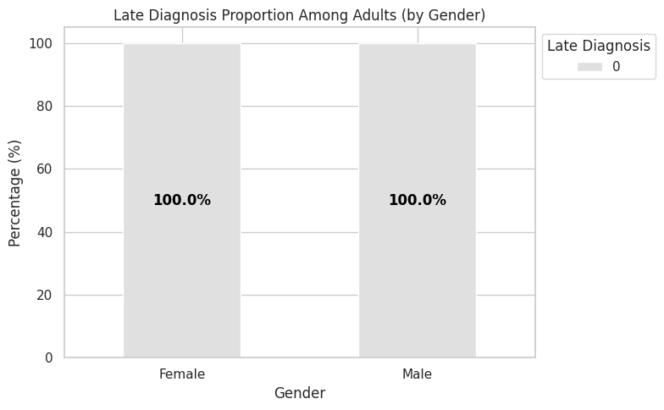
Late Diagnosis Flag — Detecting Missed Interventions
Why This Feature
The Late_Diagnosis_Flag targets one of the most critical gaps in autism care: adults (age ≥18) who receive a positive diagnosis.
Why does this matter? Early intervention (typically under age 5–7) is associated with significantly better developmental outcomes. Adults who receive a positive diagnosis in the screening dataset represent individuals who either were missed during childhood screening, masked their traits successfully, or never had access to early clinical evaluation.
This flag isolates them as a high-priority population for healthcare resource targeting.

Slide 24
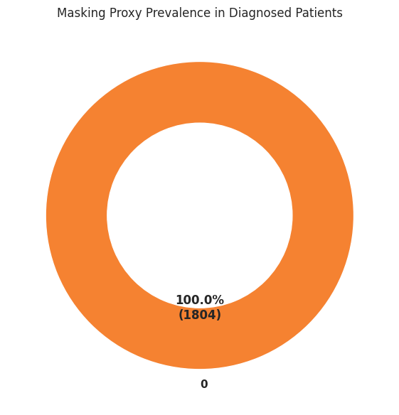
Masking Proxy Flag — Camouflaging Autistic Traits
Why This Feature
Masking (also called camouflaging) is the practice of consciously or unconsciously suppressing autistic traits to appear neurotypical.
The Masking_Proxy_Flag triggers when a patient is diagnosed with ASD (Class = 1) but self-reports their communication style as typical (A8 = 1).
Why is this clinically significant? These individuals carry the full diagnostic burden of ASD but believe — or project — that they communicate normally. They are the hardest to identify through traditional screening because their self-assessment contradicts their diagnosis.
This feature surfaces a hidden population that standard diagnostic approaches might miss or delay.

Slide 25
Key Insights — Summary
Gender Gap
Compounding Risk
Females show a 31.7% diagnosis rate vs. 28.2% for males — challenging traditional clinical assumptions.
Females with family ASD history have a 42.7% diagnosis rate — the highest intersectional risk category.
Two Screening Waves
Trait Burden Separates Populations
KDE reveals early-childhood (5–10 yrs) and young-adult (~20–30 yrs) peaks — late diagnosis is a real and sizable population.
High trait burden scores (6–10) concentrate in the diagnosed population, validating composite score utility.
The Mild Presentation Paradox
Masking & Late Diagnosis
62.58% of Mild/Typical Presentation individuals received a positive ASD diagnosis — severity alone does not predict diagnosis.
These engineered flags reveal hidden clinical populations that standard screening tools are most likely to overlook.

Slide 26
Next Steps
01
02
03
Statistical Testing
Interactive Visualizations
Analytical Dashboard
Conduct Chi-square tests and correlation matrices to find statistically significant associations between behavioral traits and ASD diagnosis.
Map trait burdens across subgroups — comparing adult females with late diagnoses to early childhood cases — using dynamic filtering.
Build a real-time dashboard allowing researchers to filter patient archetypes, demographic segments, and composite risk scores dynamically.

